Slide 1
WFSTs for ASR
Most slides come from http://www.inf.ed.ac.uk/teaching/courses/asr/2020-21/asr05-hmm-algorithms.pdf
Ying shen
School of software engineering
Tongji university

Slide 2
Weighted Finite State Transducers
Weighted finite state automaton that transduces an input sequence to an output sequence (Mohri et al 2008)
States connected by transitions. Each transition has
input label
output label
weight
Weights use the log semi-ring or tropical semi-ring – with operations that correspond to multiplication and addition of probabilities
There is a single start state. Any state can optionally be a final state (with a weight)
Used by Kaldi

Slide 3
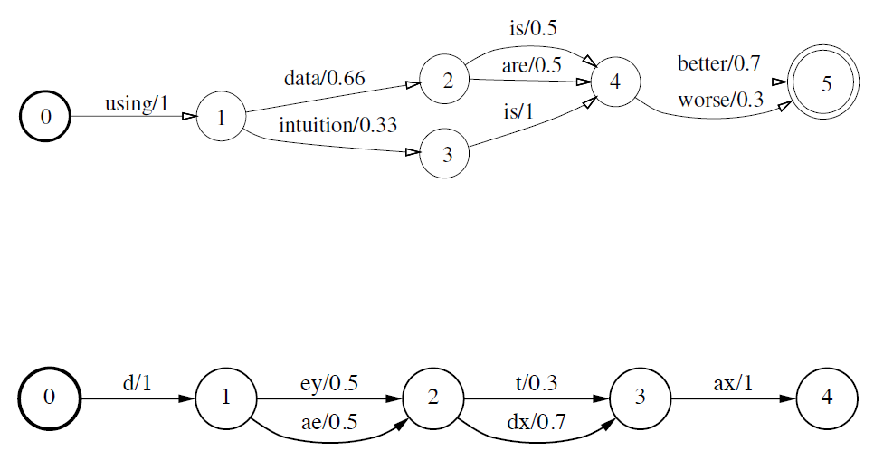
Weighted Finite State Acceptors

Slide 4
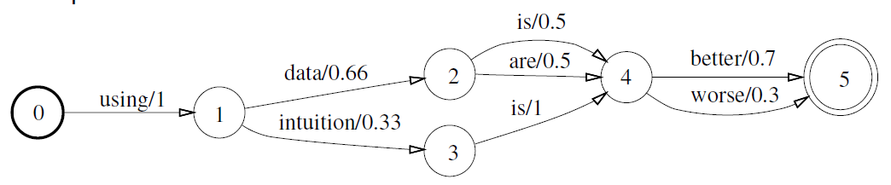
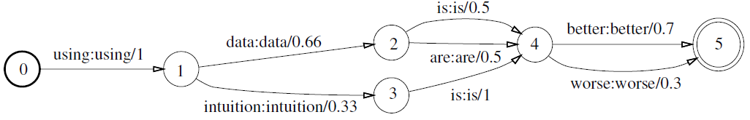
Weighted Finite State Transducers
Acceptor
Transducer

Slide 5
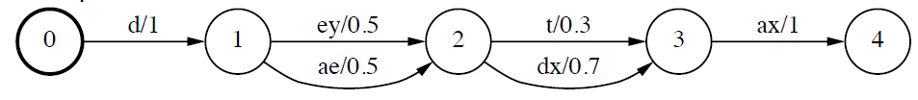
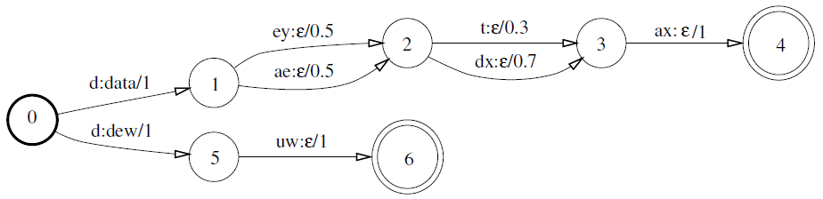
Weighted Finite State Transducers
Acceptor
Transducer

Slide 6
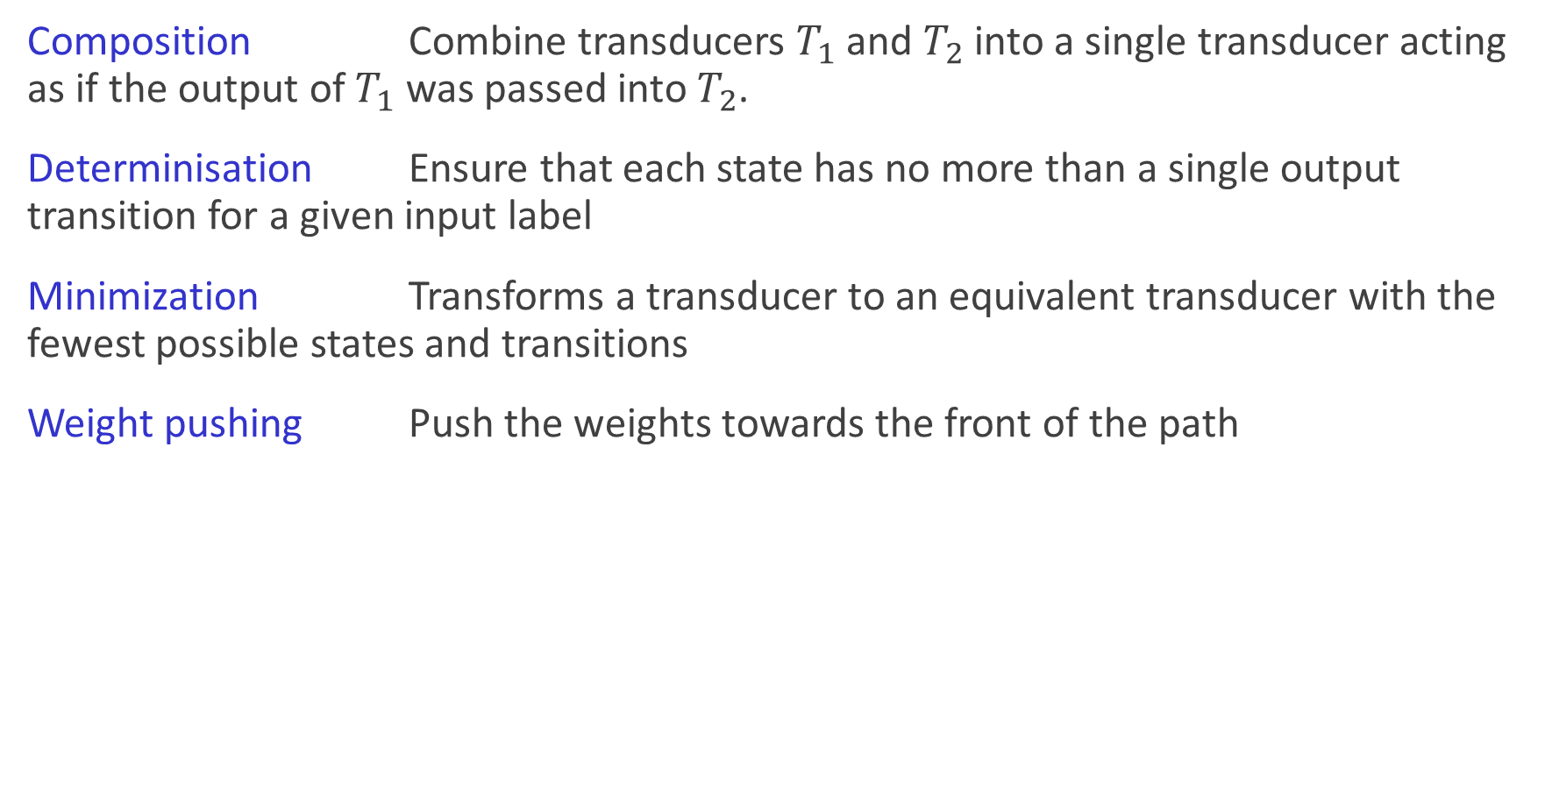
WFST Algorithms
Composition Combine transducers $T_{1}$ and $T_{2}$ into a single transducer acting as if the output of $T_{1}$ was passed into $T_{2}$.
Determinisation Ensure that each state has no more than a single output transition for a given input label
Minimization Transforms a transducer to an equivalent transducer with the fewest possible states and transitions
Weight pushing Push the weights towards the front of the path

Slide 7
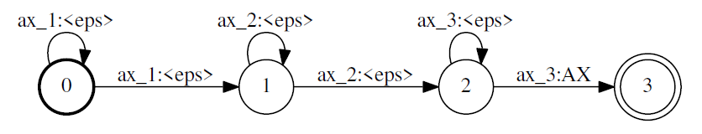
The HMM as a WFST
ax_1
ax_2
ax_3
S_{E}

Slide 8

Applying WFSTs to speech recognition
Represent the following components as WFSTs
Composing $L$ and $G$ results in a transducer $L∘G$ that maps a phone sequence to a word sequence
$H∘C∘L∘G$ results in a transducer that maps from HMM states to a word sequence
 | transducer | input sequence | output sequence
G | word-level grammar | words | words
L | pronunciation lexicon | phones | words
C | context-dependency | CD phones | phones
H | HMM | HMM states | CD phones

Slide 9
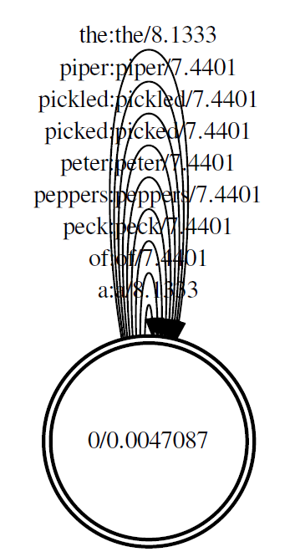
Grammar - unigram

Slide 10
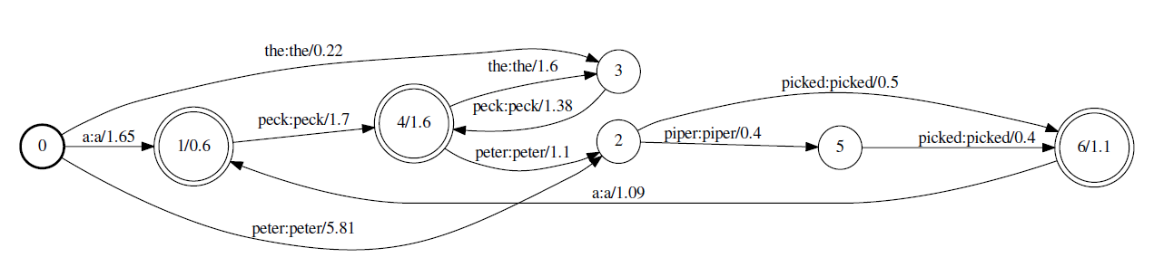
Grammar - bigram

Slide 11
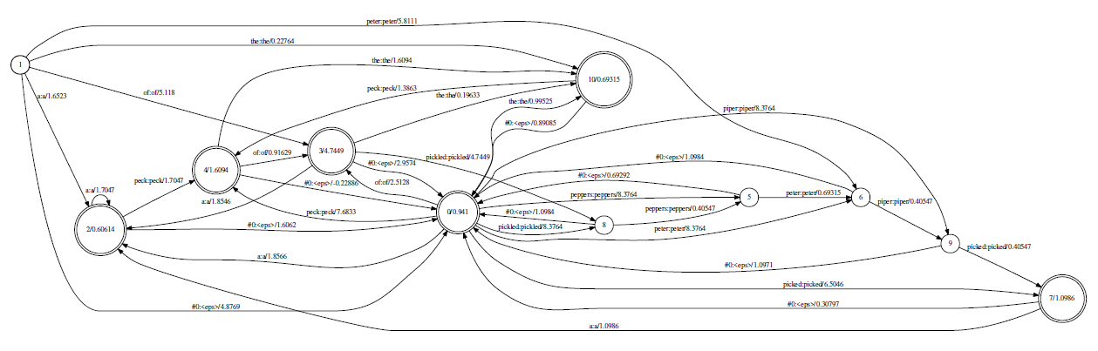
Bigram with back-off

Slide 12
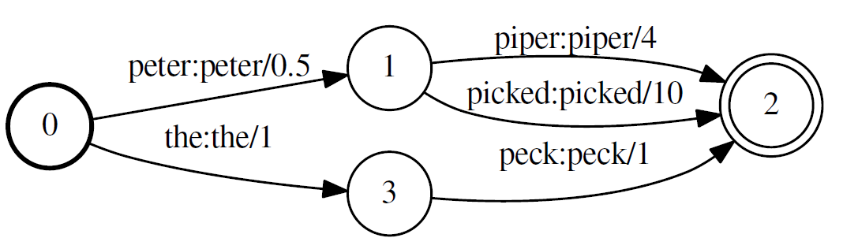
Weight pushing

Slide 13
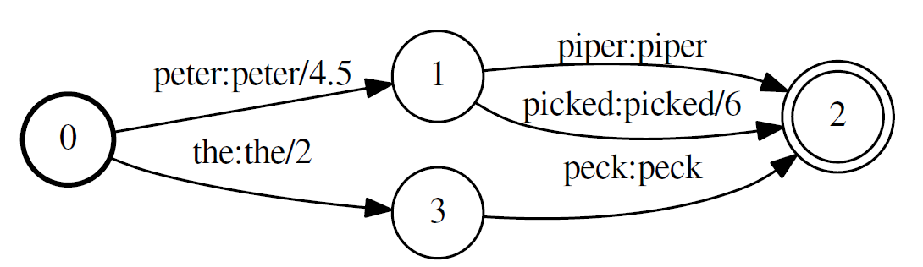
Weight-pushed version

Slide 14
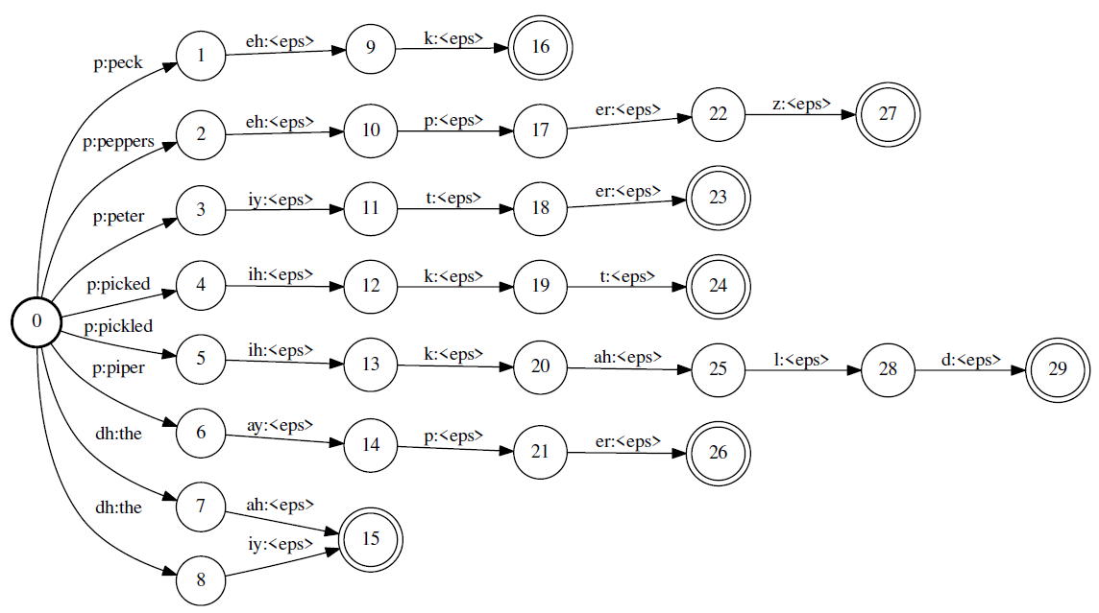
Lexicon, L

Slide 15
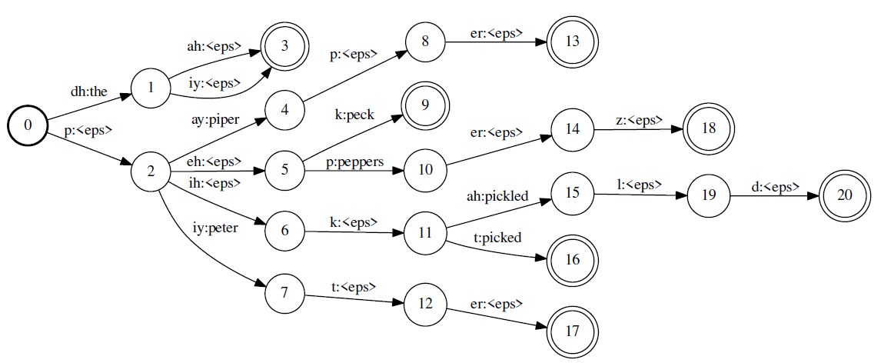
Determinization - det(L)

Slide 16
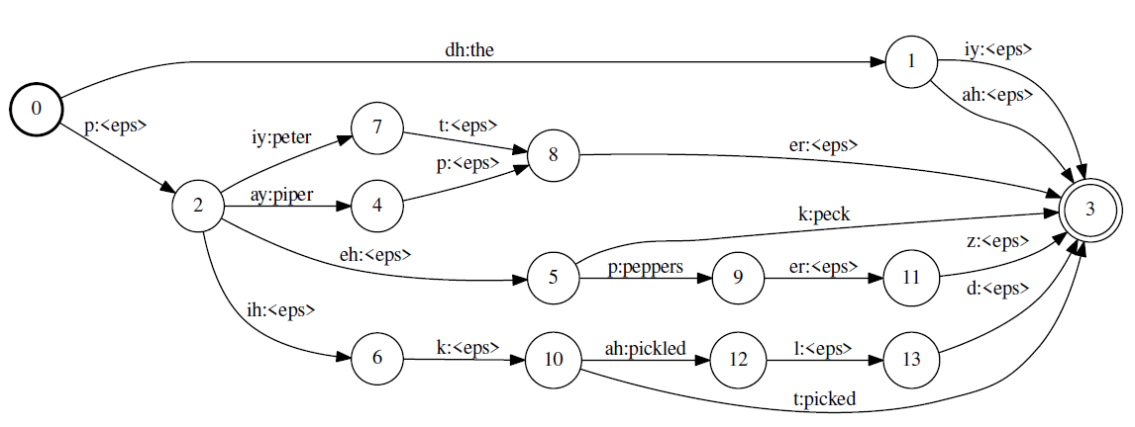
Minimization - min(det(L))

Slide 17
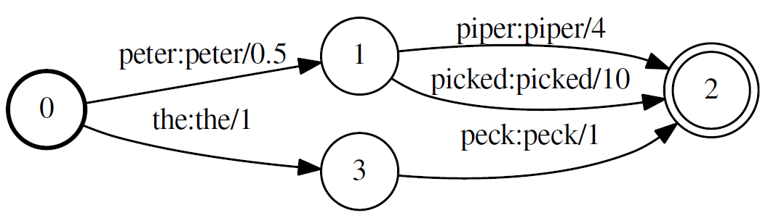
Composition

Slide 18
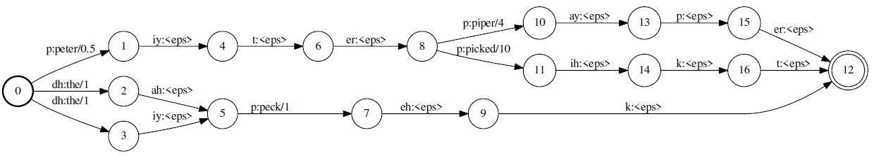
Composition: $L∘G$

Slide 19
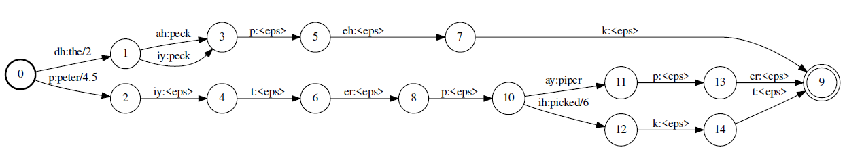
min(det($L∘G$))

Slide 20
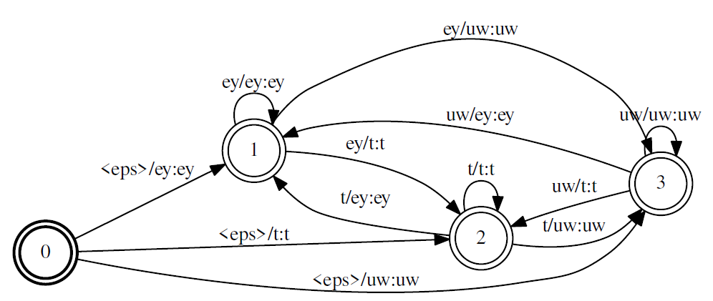
Context-dependency: biphones

Slide 21
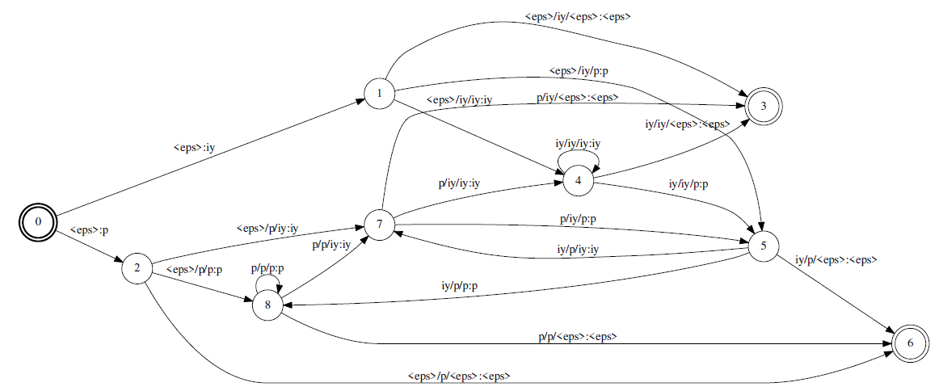
Context-dependency: triphones

Slide 22
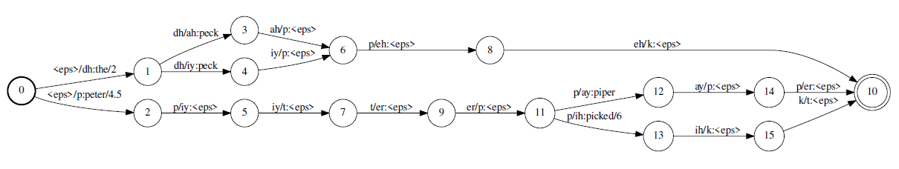
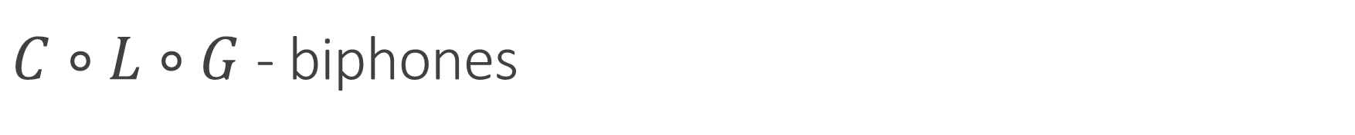
$C∘L∘G$ - biphones

Slide 23
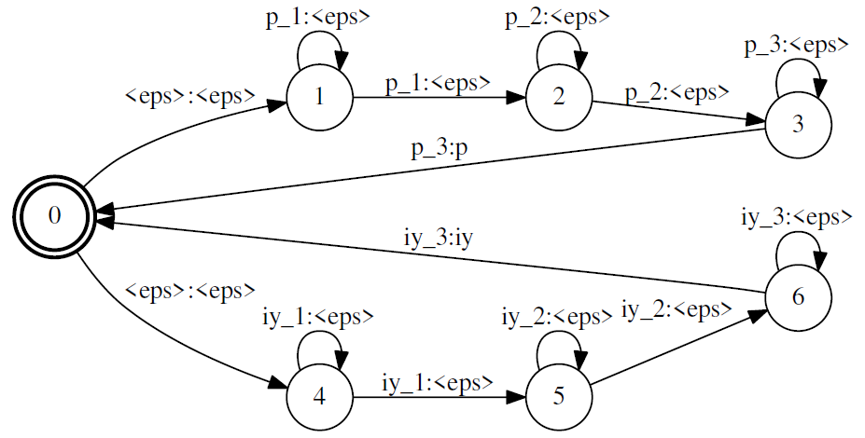

HMM transducer, $H$
We can also use a version that outputs context-dependent phones
$H$ can be used to encode state-tying

Slide 24
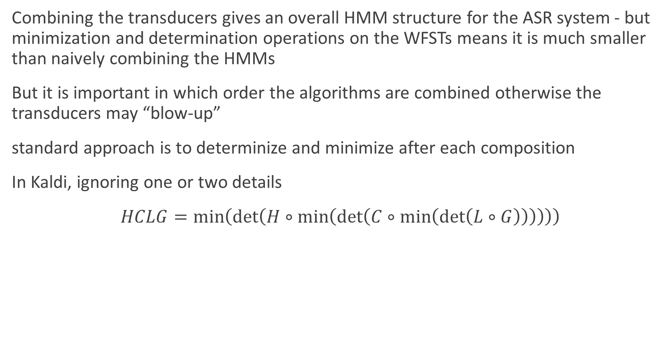
Decoding using WFSTs
Combining the transducers gives an overall HMM structure for the ASR system - but minimization and determination operations on the WFSTs means it is much smaller than naively combining the HMMs
But it is important in which order the algorithms are combined otherwise the transducers may “blow-up”
standard approach is to determinize and minimize after each composition
In Kaldi, ignoring one or two details
$HCLG=\min\left(\det\left(H∘\min\left(\det\left(C∘\min\left(\det\left(L∘G\right)\right)\right)\right)\right)\right)$

Slide 25
Reading
Mohri et al (2008). “Speech recognition with weighted finite-state transducers.” In Springer Handbook of Speech Processing, pp. 559-584. Springer. http://www.cs.nyu.edu/~mohri/pub/hbka.pdf
WFSTs in Kaldi. http://danielpovey.com/files/Lecture4.pdf

